Slide 1
Houses Sale in Salt Lake County, Utah
Bao Chau Pham

Slide 2
Introduction
Home sales prices in Utah have been gradually increasing.
In this project, we will examine home sales prices in Salt Lake City, Utah.
Analyze the home sales data to answer the question whether the number of venues around a home impact its price.
This data analysis will be beneficial to people who are currently looking to buy an affordable home in Salt Lake County.

Slide 3
Data
For this problem, we will need the following data:
• List of homes for sale in Salt Lake County.
• Data of venues in Salt Lake County.
• Data of coordinates of venues and homes in Salt Lake County.
To acquire these data, we use the sources:
• The list of homes for sale in Salt Lake County downloaded from redfin.com.
• Number of venues, their coordinates and categories using Foursquare API.
• Coordinates of homes using Google Maps API geocoding

Slide 4
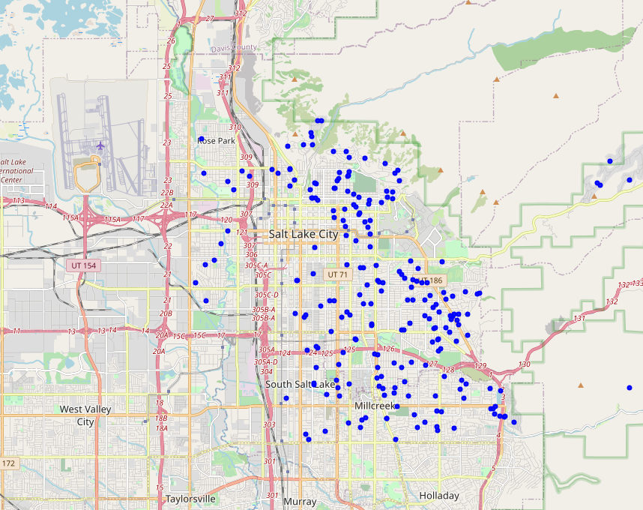
Map of homes for sale
We narrow the homes to the type of Single Family Residential.

Slide 5
Methodology
We use Google Geocoding API to obtain the coordinates of homes and also the coordinates of cities in Salt Lake County.
To compare the prices among cities, we calculate the average price of each city, and show the top 5 cities. Then we will visualize the average prices using a Choropleth map.
To analyze the impact of venues to home prices, we will get the number of venues per home and the number of venue categories per home by counting venues and venue categories based on the data. From that, we will use Scatter plots to visualize the relation between them to see if we can build a model for them.

Slide 6
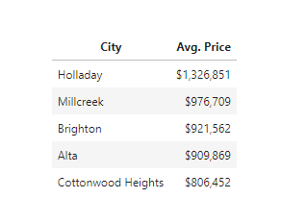
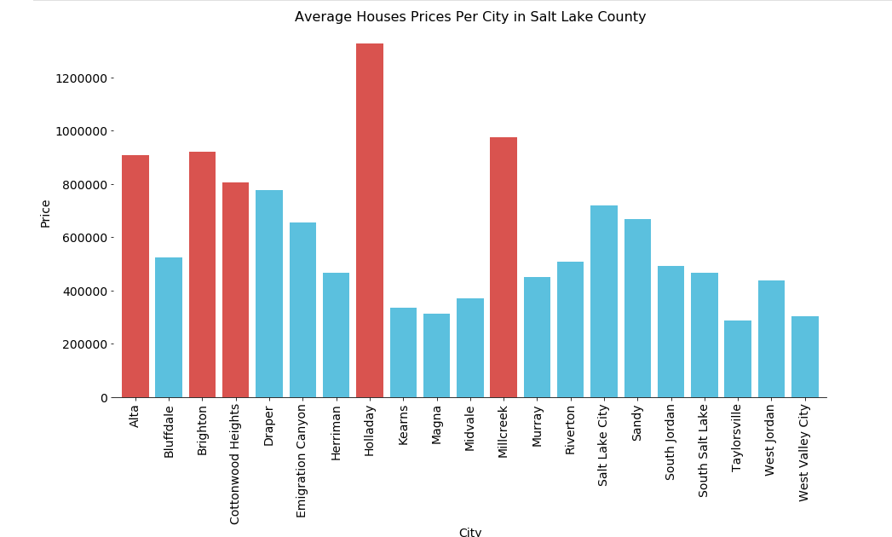
Analysis: top 5 cities with highest average homes sale prices

Slide 7
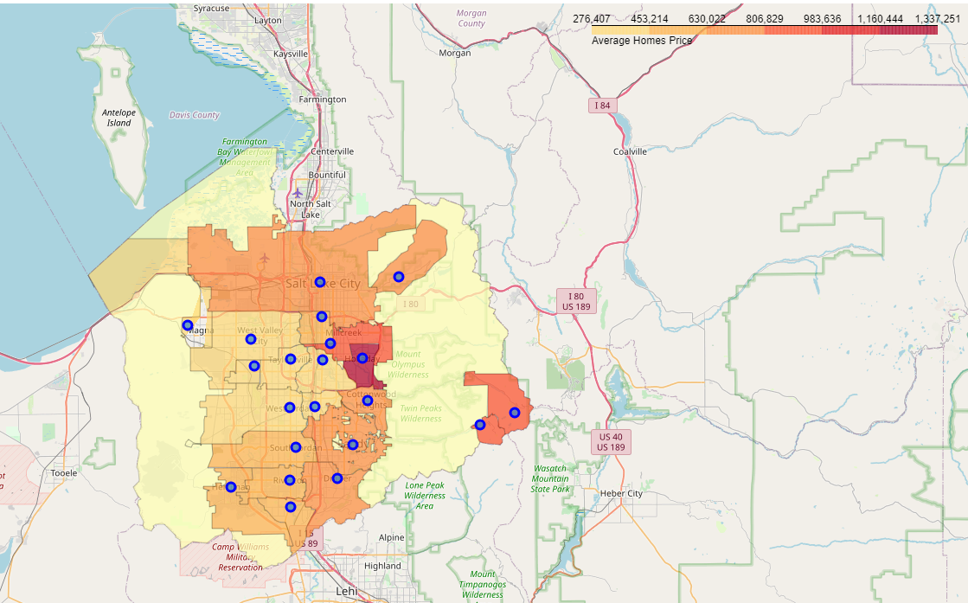
Analysis
When looking at the Choropleth map, we notice that the cities near the Wasatch Range have higher average homes prices.

Slide 8
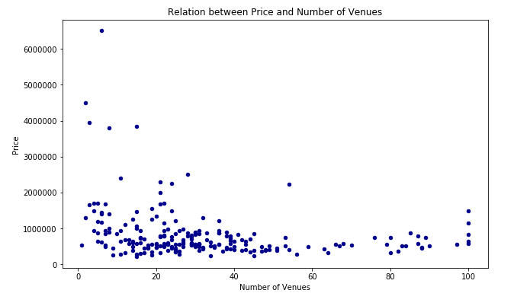
Analysis
We will find out the relation between the number of venues and Price.
Since Scatter charts allow us to see the relation between two variables, we can apply it in this case.
The points in the chart mostly are at the bottom of the chart, so we can’t build a model, and there is no relation between the number of venues and Price.

Slide 9
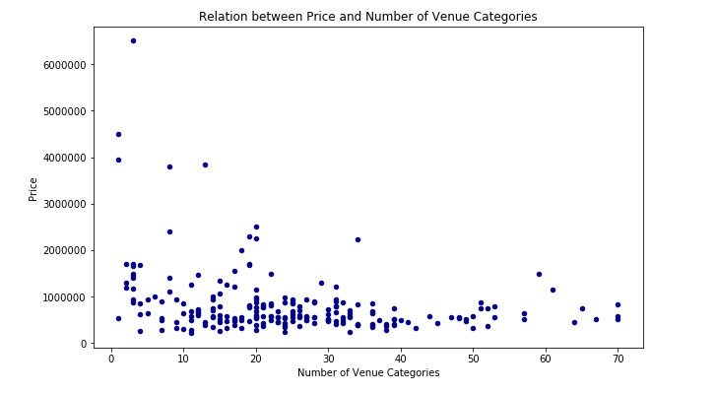
Analysis
We will apply the same approach for the number of venue categories.
It looks like we can’t either build a model for this chart, so there is no relation between the number of venue categories and Price.

Slide 10
Conclusion
The top five cities which have the highest home prices are: Holladay, Millcreek, Brighton, Alta, and Cottonwood Heights.
Homes near the Wasatch Range have higher prices than other homes.
The number of venues and the number of venue categories near a home don't impact its price.

